Slide 1

Summer Olympics Data EDA Report 1896 - 2012
KBUDEMA

Slide 2
Project Introduction
Datasets Used : Summer Olympics dataset from INSAID GitHub and Google data of countries and their GDP (As supporting).
The goal of the analysis is to understand the behavior of different countries participating as per their economic conditions and number of medals won by different gender, sport, Medal Types, Cities hosting the games etc.
It has 9 columns and 31665 records.

Slide 3
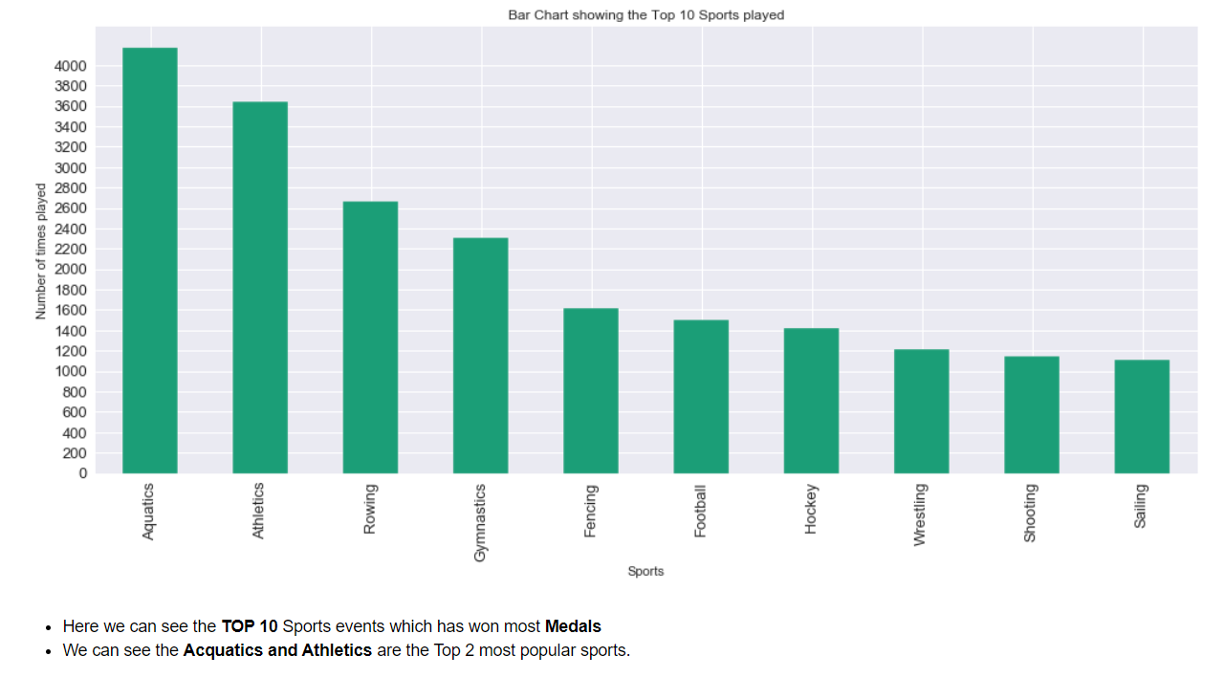

Slide 4
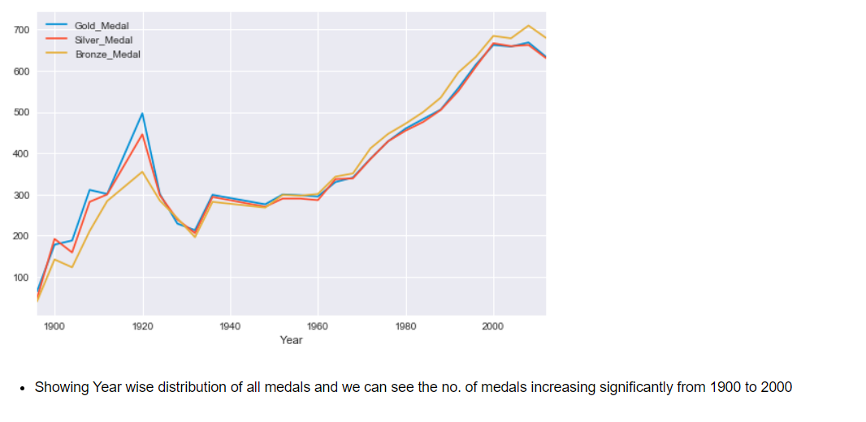

Slide 5
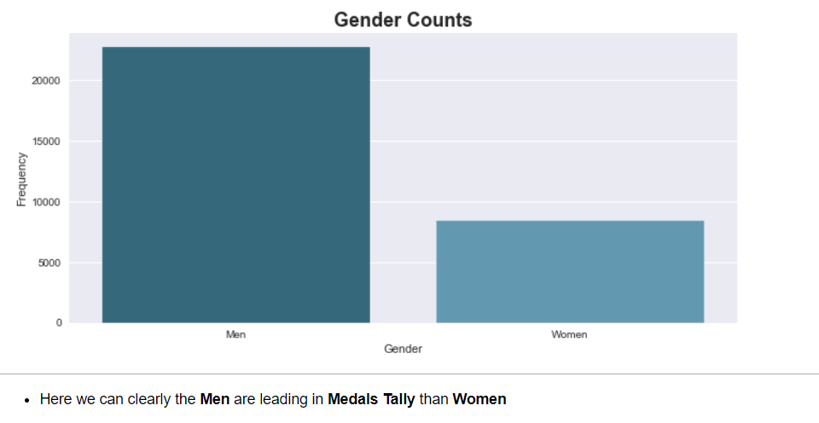

Slide 6
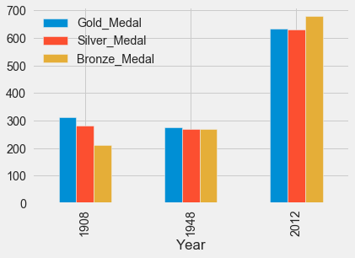
Here we can see that London City has hosted the Olympics maximum times and 2012 is significantly high than 1908

Slide 7
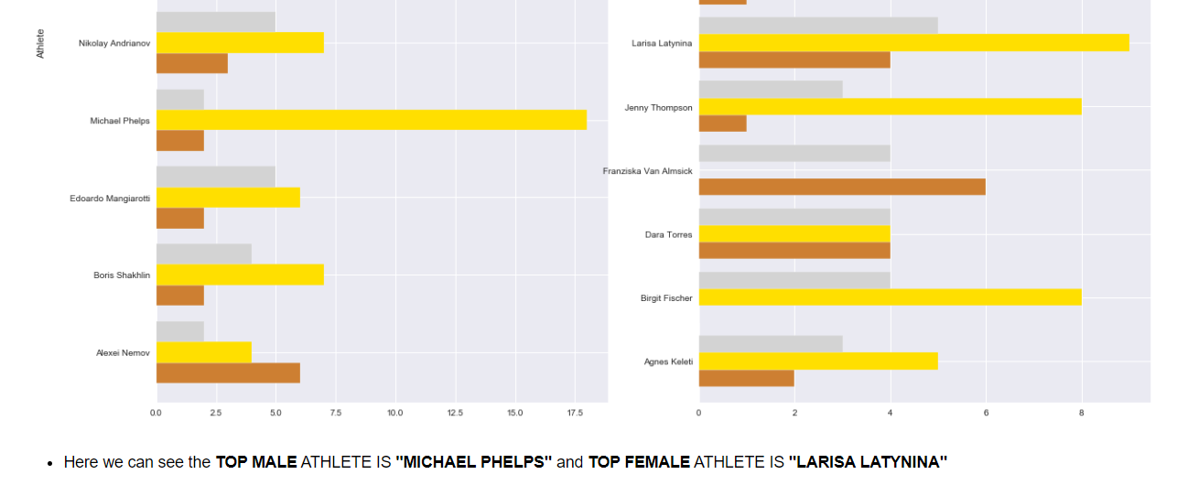
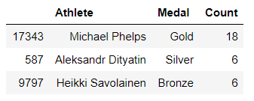

Slide 8
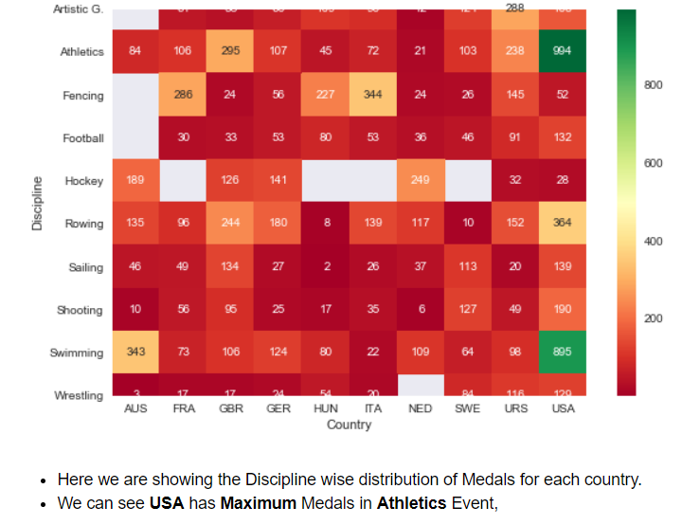

Slide 9
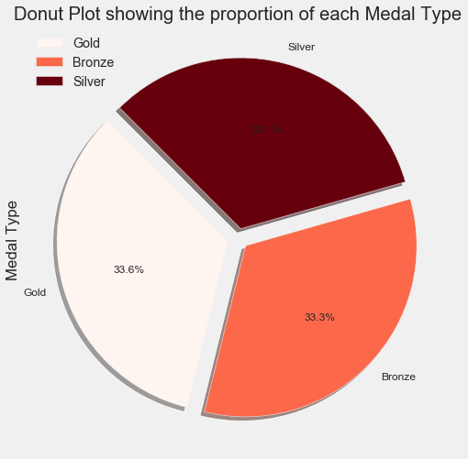

Slide 10
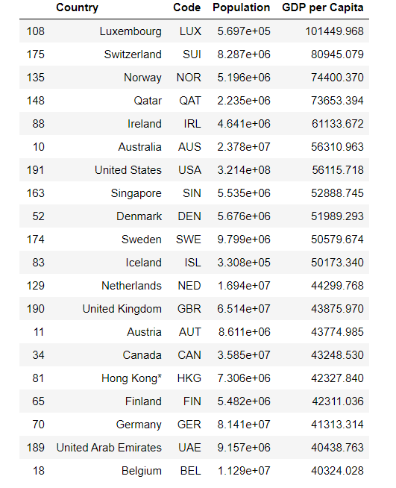
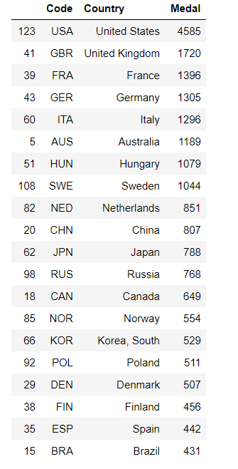
The no. of countries earned medals during Olympics is having relation with their economic conditions.
Top 20 Countries showing their GDP
Top 20 Countries showing their Medals

Slide 11
Recommendations
In This Analysis, we can see the trend and rise of Modern Olympics in more than 100 years history and how the popularity of Olympics has made them one of the favorite games of every sports person in the every corner of the world.
The GDP of the country and Medals count correlation is quite high as higher the GDP of the country, higher the number of medals.
Male Athletes are more than Women Athletes but the no. of women also increases over period of time as compared to Men.
Proportion of each medal type is same
Aquatics and Athletics are more popular sports
Men's Medal tally is more than double of Woman’s

